Slide 1
Electric-Field Mapped Averaging for Dielectric Constant
Weisong Lin
10/2/2015

Slide 2
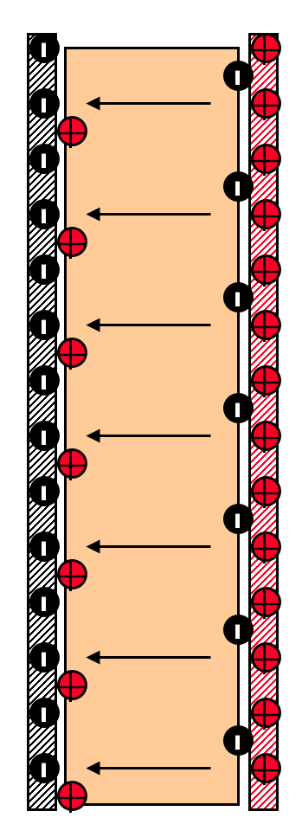
Definition
The dielectric constant (relative permittivity) of a material is the ratio of permittivity or capacitance to that of vacuum. Dielectric is another name for an insulator (non-conductor). Dielectrics can polarize in the presence of an electric field.
Vacuum
-Q
+Q
Dielectric: Polarization
d
Electric
filed E
Plate
Area A
Dielectric Constant
Capacitor with a dielectric inside

Slide 3
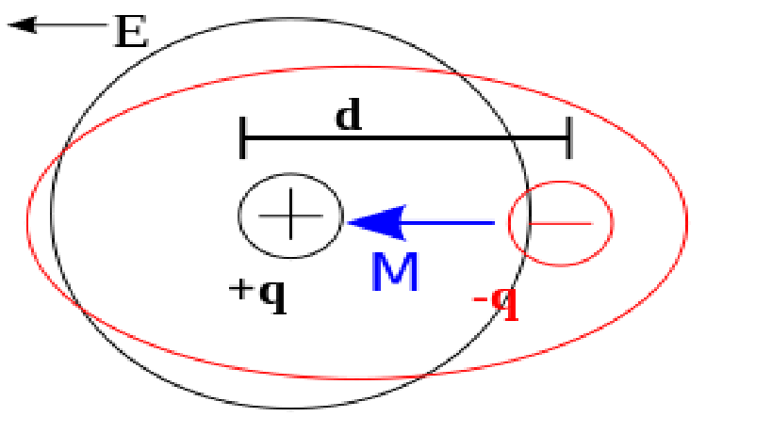
Dielectric polarization
Basic atomic model
Dipole polarization
Ionic polarization
H⁺
O⁻
M
H⁺

Slide 4
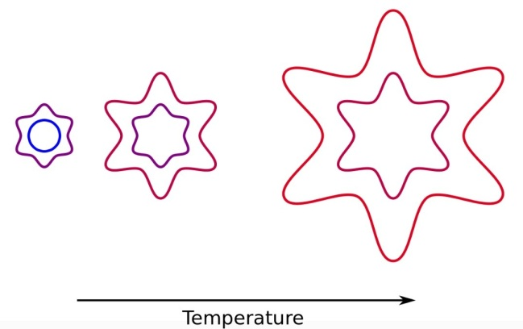
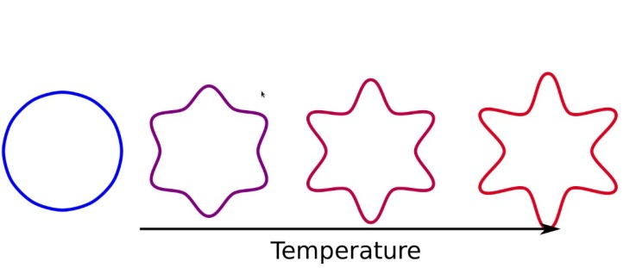
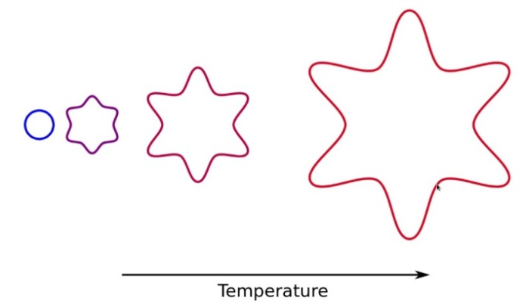
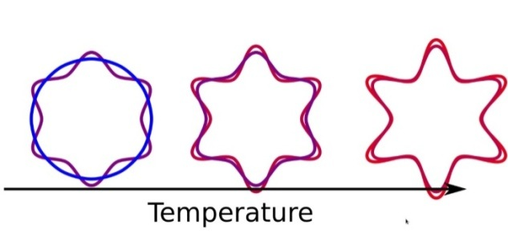
Mapped average
Mapped average improves the free-energy perturbation (FEP) by coupling to displacement of coordinates.
Standard FEP:
Introduce mapping to improve precision:

Slide 5
Dielectric constant is 2nd derivative with respect to an imposed electric field
Conventional :
Coordinate
Boltzmann factor
Partition function
Mapping satisfies
θ
x = 1
x = -1
E

Slide 6
Mapped averaging formulas:
Stockmayer system.
Dipole Lennard-Jones fluid
Lennard-Jones potential
Dipole-dipole potential

Slide 7
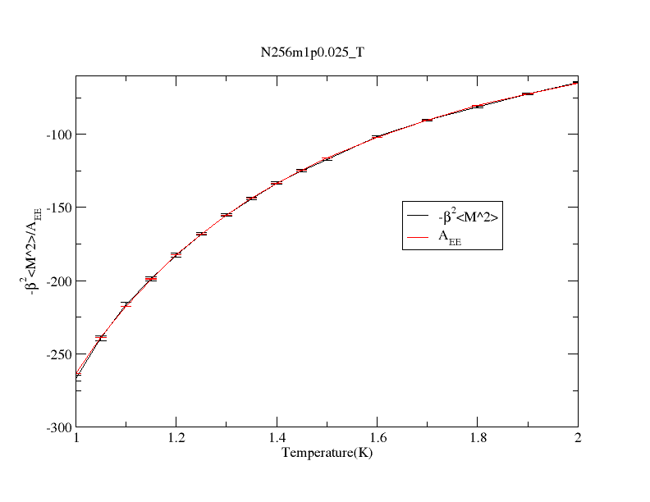

Results
N256m1$ρ0.025_T$
Number of molecules:256
Dipole strength: 1
Density: 0.025(simulation unit)

Slide 8
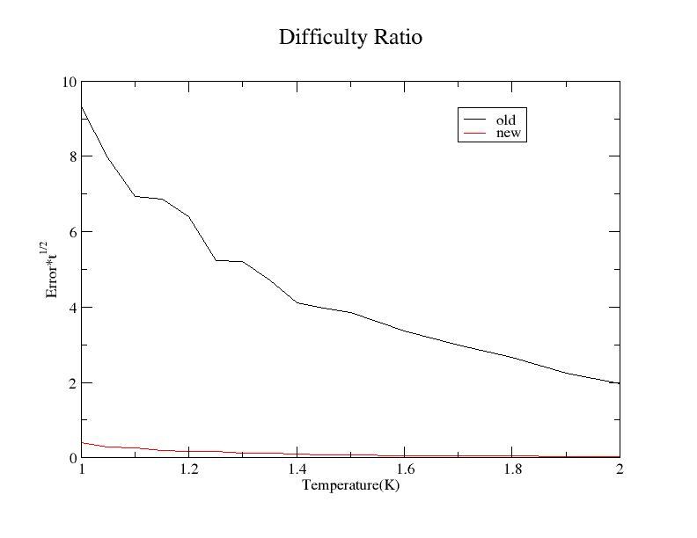
Results
Comparison of CPU times
Number of molecules:256
Dipole strength: 1
Density: 0.025(simulation unit)

Slide 9
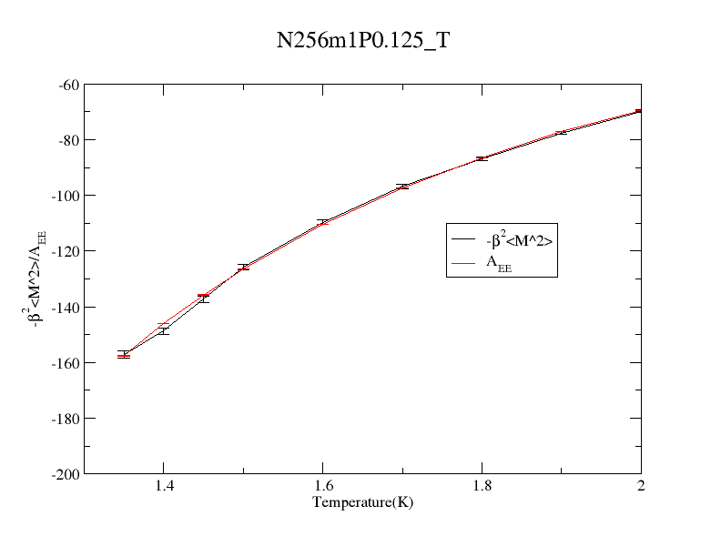
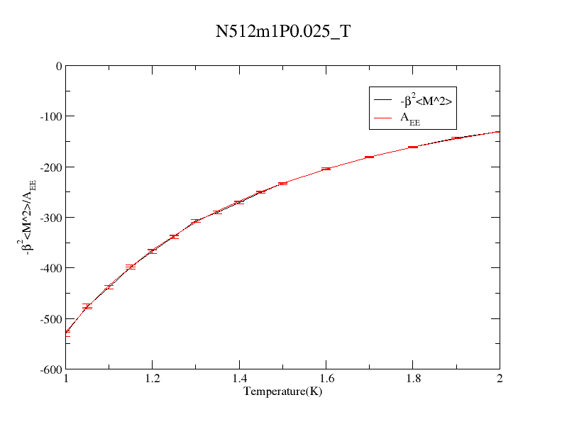
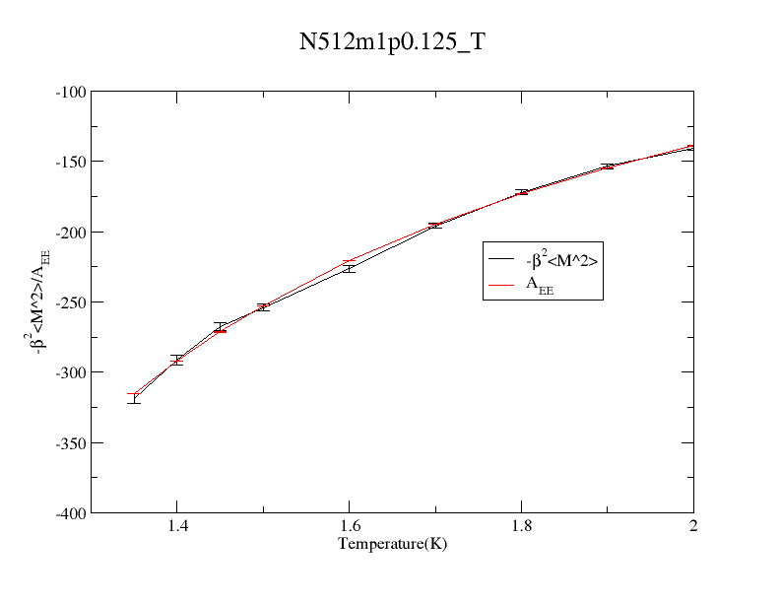
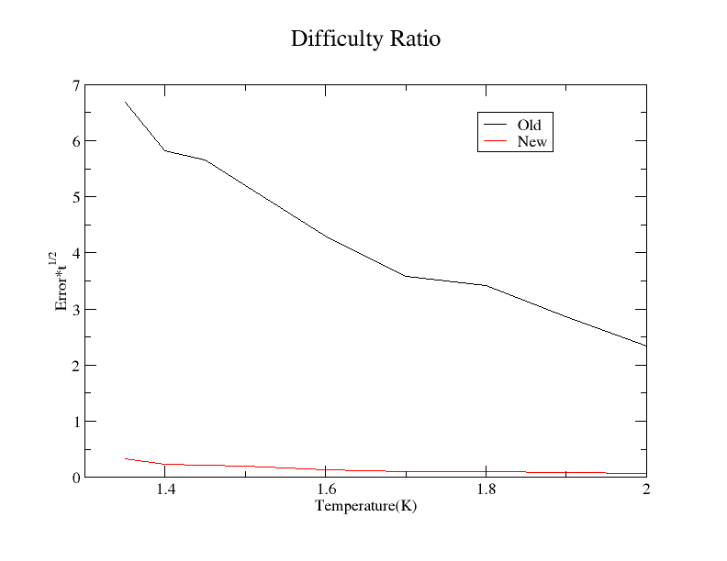
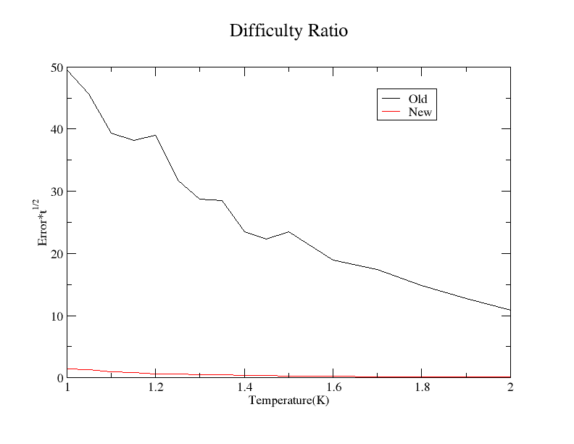
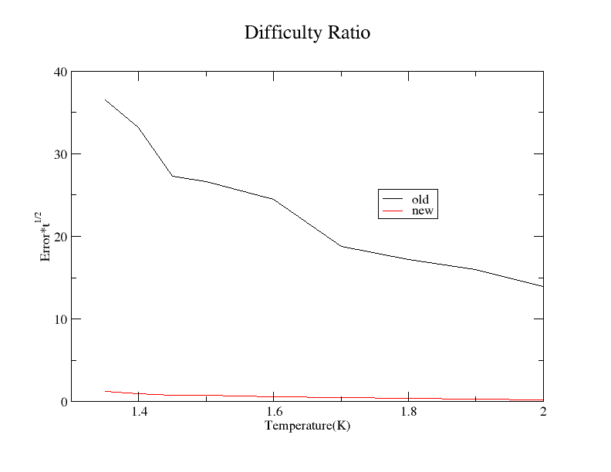
Comparison of CPU times
Comparison of CPU times
Comparison of CPU times

Slide 10
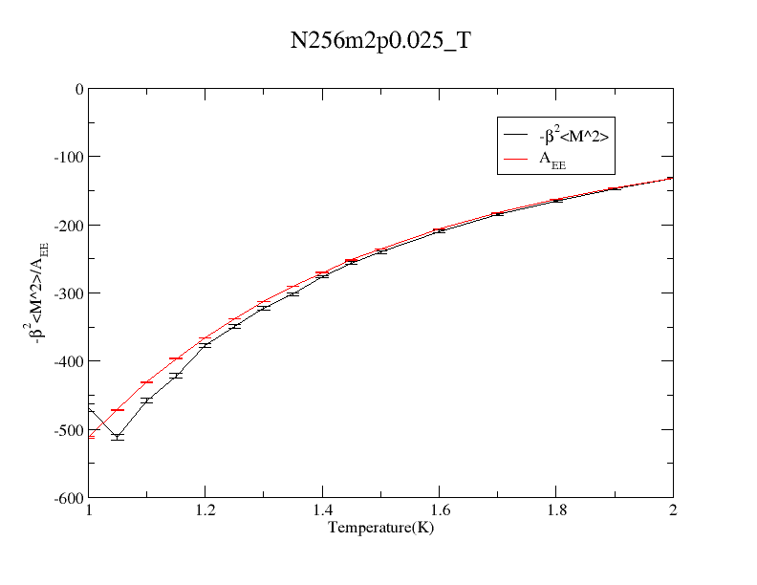
However

Slide 11
Current formulas:
Edit formulas:

Slide 12
We got more to do!
Thank you.

